Slide 1
Spring 2022 COMP 3511 Review #3

Slide 2
Coverages
Thread
CPU Scheduling

Slide 3
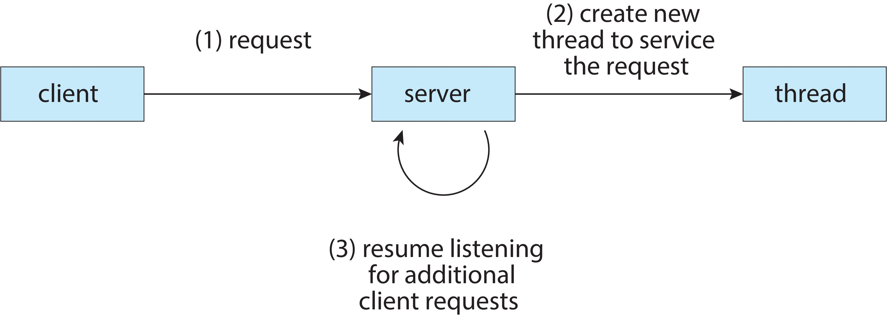
Asynchronous Threading
Asynchronous threading
When a parent creates a child thread, the parent resumes its execution, so that the parent and child execute concurrently and independently of one another. Because the threads are independent, there is typically little data sharing between them

Slide 4
Synchronous Threading
Synchronous threading
Synchronous threading occurs when a parent thread creates one or more children and then must wait for all of its children threads to terminate before it continues execution. Thus, the threads created by the parent perform work concurrently, but the parent cannot continue until this work has been completed. Once each thread has finished its work, it terminates and joins with its parent. Only after all of the children have joined, can the parent resume execution.
Typically, synchronous threading involves significant data sharing among threads
For example, this can be used when the parent thread may combine the results calculated by its many children threads

Slide 5
Pthreads
Pthreads - POSIX standard (IEEE 1003.1c) defining an API for thread creation and synchronization. This is a specification for thread behaviour, not an implementation. Different Unix-like OS implements this differently
The C program shown next demonstrates the basic Pthreads API for constructing a multithreaded program that calculates the summation of a non-negative integer in a separate thread.
In this Pthreads program, separate threads begin execution in a specified function - the runner() function
When this program begins, a single thread of control (the parent thread) begins in main(). After some initialization, main() creates a second thread (the child thread) running runner() function. Both threads share the global data sum
This program follows the thread create/join strategy, whereby after creating summation thread – the parent thread waits for the completion of child thread
Once the summation thread has returned, the parent thread will output the value of the shared data sum

Slide 6
Pthreads

Slide 7
Pthreads Example
In a Pthreads program, separate threads begin execution, specifically
All Pthreads programs must include the pthread.h header file
The pthread_t declares the identifier for the thread to be created
The pthread_attr_t represents the attributes for the thread (stack size and scheduling information. Here default attributes are used)
A thread created with pthread_create(), with the thread identifier, attributes, function (i.e., the runner()), the integer parameter (i.e., argv[1])
The program has two threads: the initial (or parent) thread in main() and the summation (or child) thread performing summation in the runner() function
The parent thread waits for its child to terminate by calling pthread_join() function
The summation thread will terminate when it calls function pthread_exit()

Slide 8
pthread_create function
#include <pthread.h>
int pthread_create( pthread_t * thread,
const pthread_attr_t * attr,
void * (*start_routine)(void*),
void * arg);
thread, is a pointer to a structure of type pthread_t;
attr, is used to specify any attributes this thread might have;
Function pointer;
arg, the argument to be passed to the function where the thread begins execution.

Slide 9
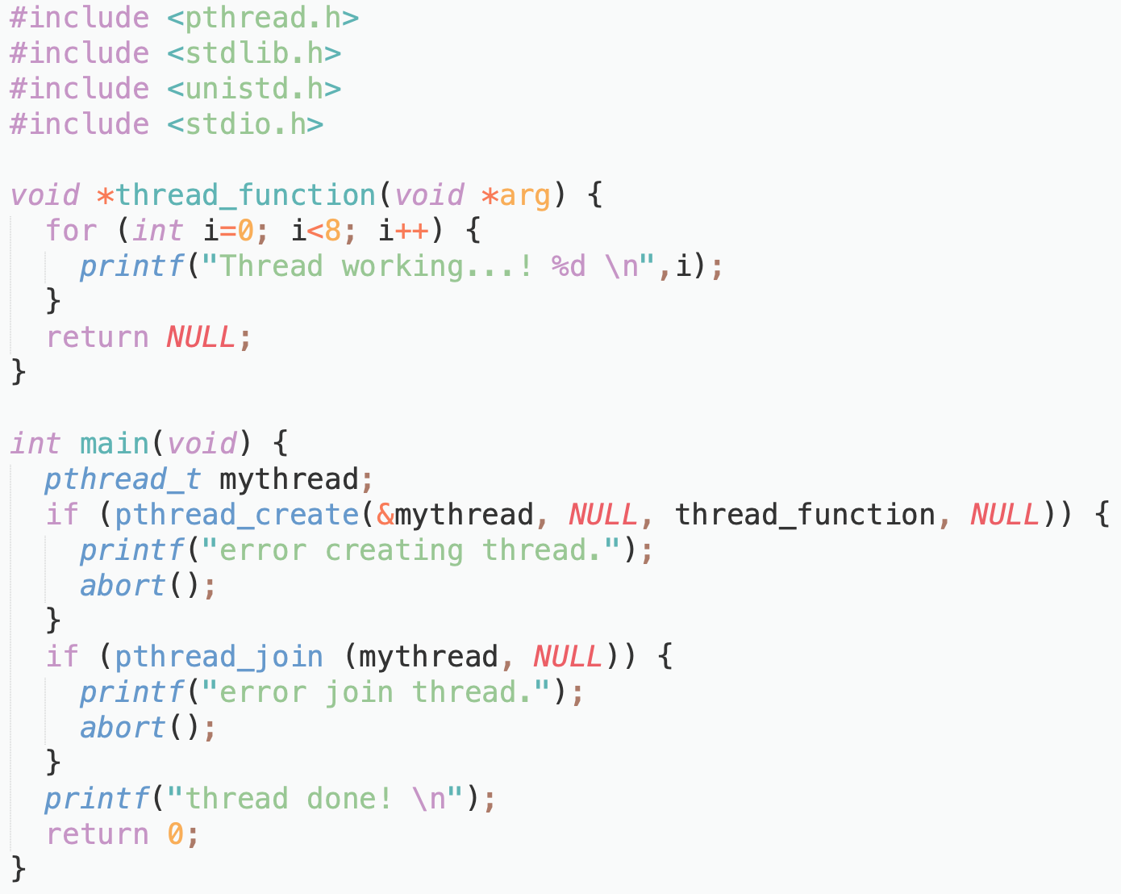
Pthreads Example: Create & Join

Slide 10
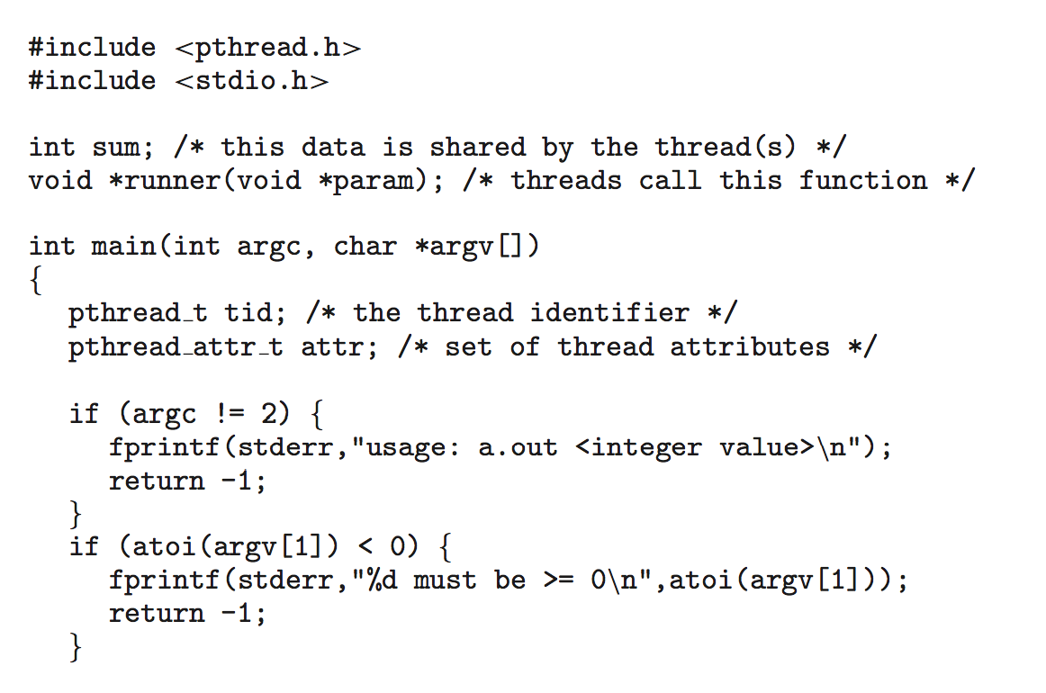
Pthreads Example (Cont.)

Slide 11
Pthreads Example (Cont.)

Slide 12
Test the pthread program
Compile the C program.
pthread is required in the linking process to generate the executable
> gcc pthread_demo.c -lpthread -o pthread_demo
> ./pthread_demo 2
sum of 1..2 = 3
> ./pthread_demo 1000
sum of 1..1000 = 500500

Slide 13
Pthreads Code for Joining 10 Threads
A simple method for waiting on multiple threads using pthread_join() function is to enclose the operation within a simple for loop.
For example, join on ten threads using the Pthread code below

Slide 14
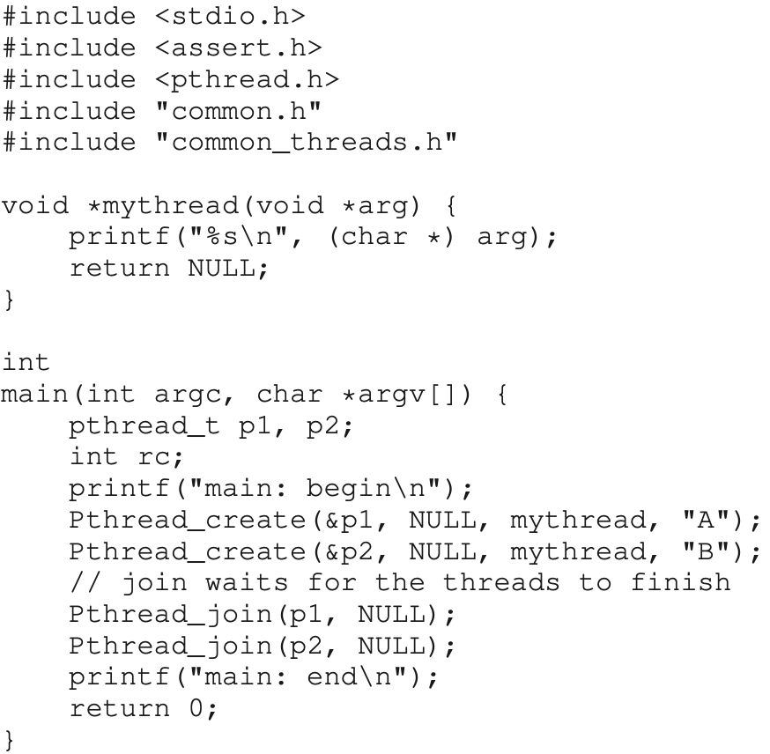
Another Pthreads example

Slide 15
Trace the threads(1)
main
Thread 1
Thread 2
starts running
prints “main: begin”
creates Thread 1
creates Thread 2
waits for T1
runs
prints “A”
returns
waits for T2
runs
prints “B”
returns
prints “main: end”

Slide 16
Trace the threads(2)
main
Thread 1
Thread 2
starts running
prints “main: begin”
creates Thread 1
runs
prints “A”
returns
creates Thread 2
runs
prints “B”
returns
waits for T1
returns immediately; T1 is done
waits for T2
returns immediately; T2 is done
prints “main: end”

Slide 17
Time to consider…
Will there be any other possible outputs?
Will Thread1 runs after Thread2?

Slide 18
Trace the threads(3)
main
Thread 1
Thread 2
starts running
prints “main: begin”
creates Thread 1
creates Thread 2
runs
prints “B”
returns
waits for T1
runs
prints “A”
returns
waits for T2
returns immediately; T2 is done
prints “main: end”

Slide 19
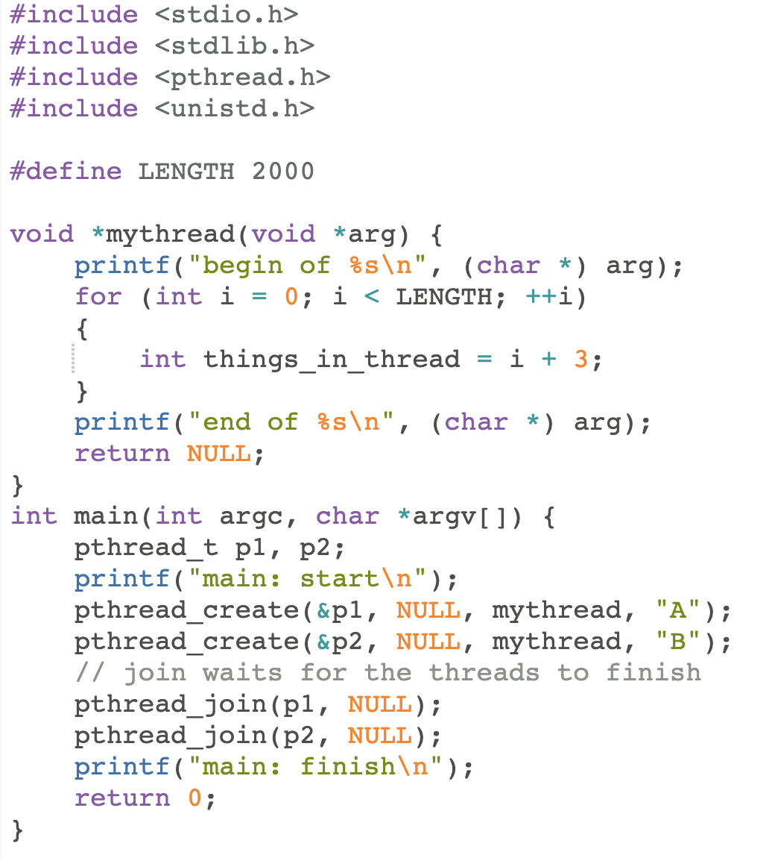
Extend this example…

Slide 20
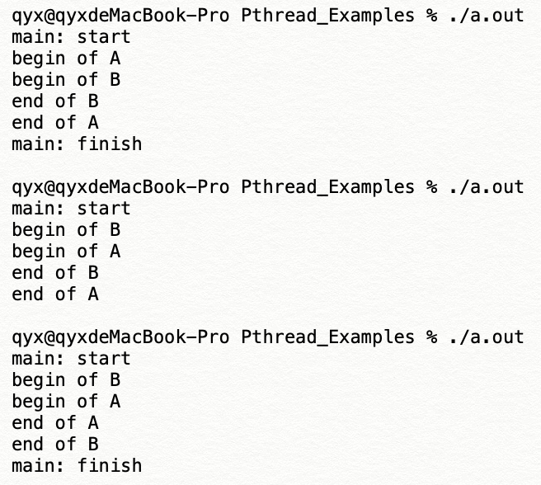
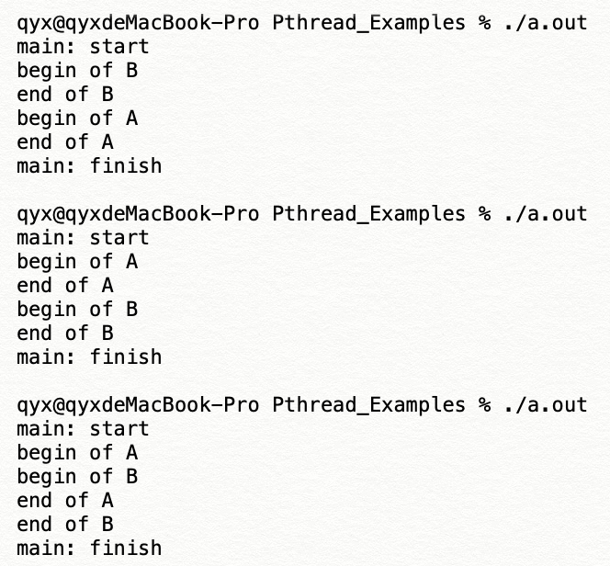
What is the possible outputs?
How many possible outputs of this example?
Considering different orders, there should be 6 possible outputs

Slide 21
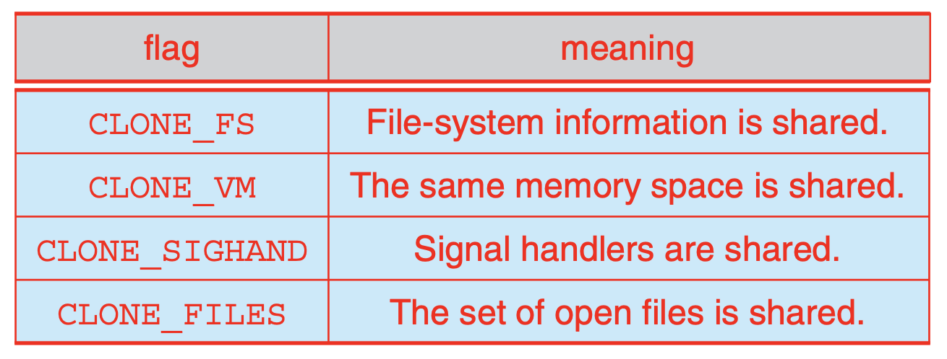
Clone
The clone() system call creates a new child process or called a task.
Compared to fork(), clone() provides more precise control over what pieces of execution context are shared between the calling parent process and the child process – for example, clone() can control whether the two processes share the virtual address space, the table of file descriptors, and the table of signal handlers.

Slide 22
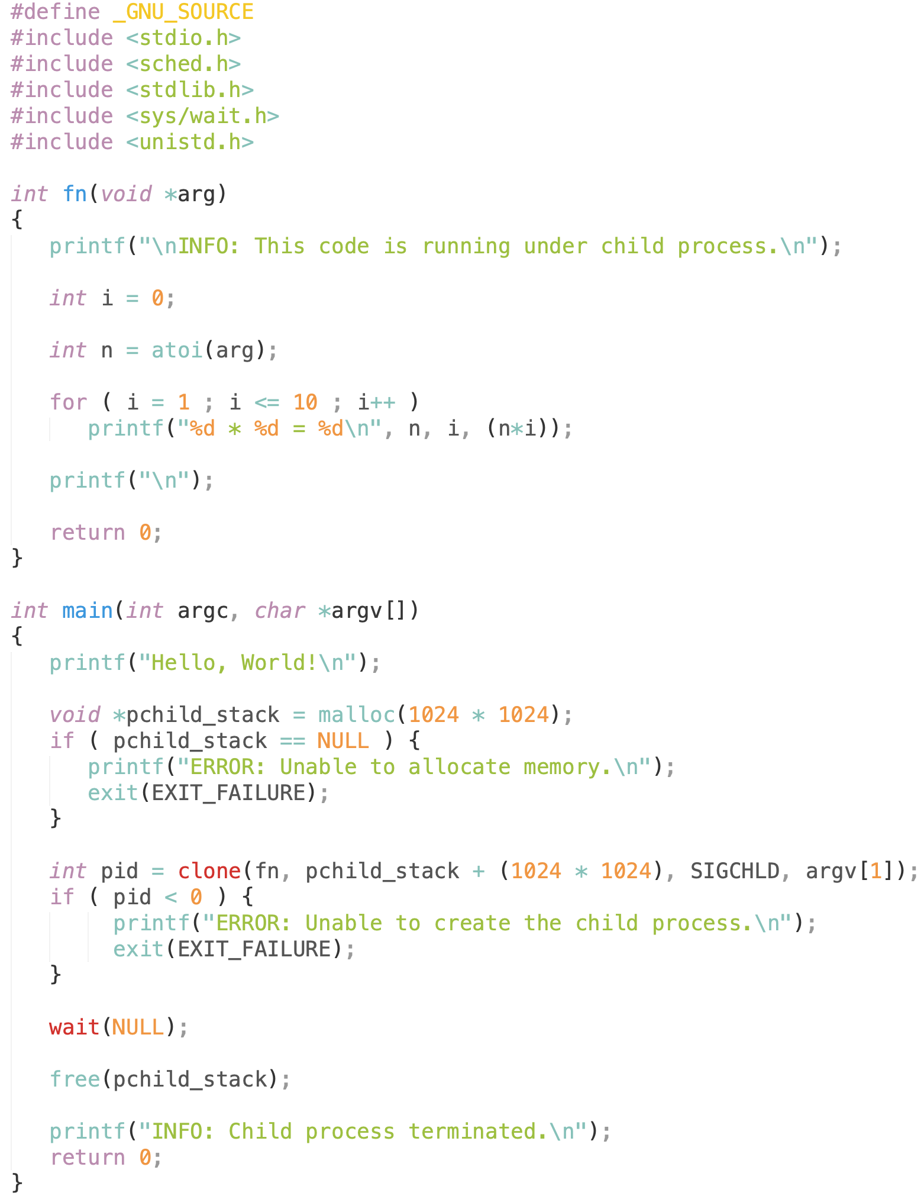
Simple example of clone()

Slide 23
Outputs of this example
$ ./simple_example_of_clone 7
Hello, World!
INFO: This code is running under child process.
7 * 1 = 7
7 * 2 = 14
7 * 3 = 21
7 * 4 = 28
7 * 5 = 35
7 * 6 = 42
7 * 7 = 49
7 * 8 = 56
7 * 9 = 63
7 * 10 = 70
INFO: Child process terminated.

Slide 24
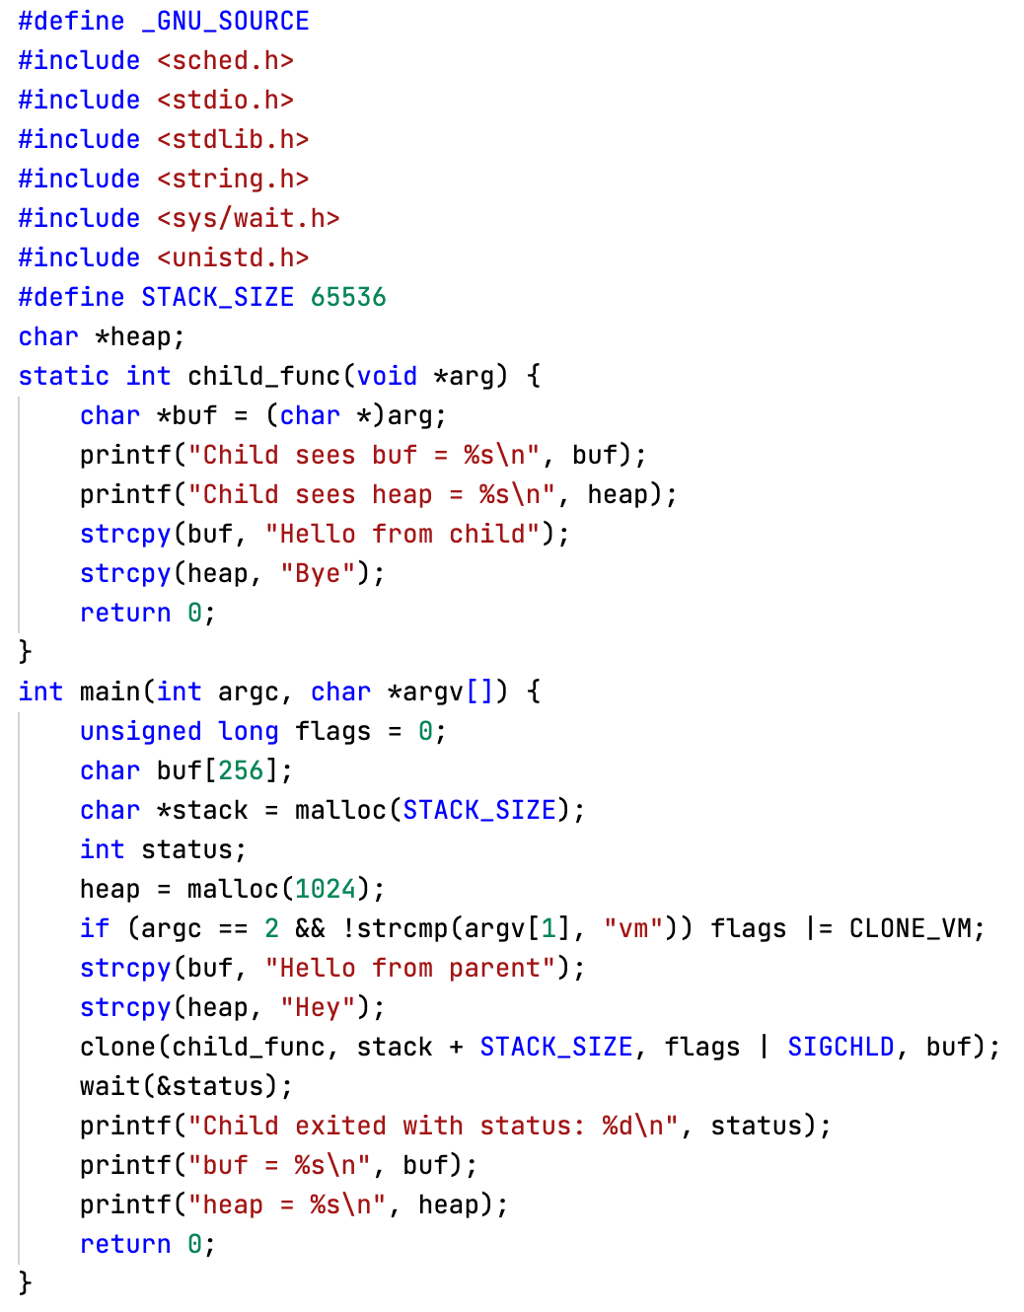
Example of clone()

Slide 25
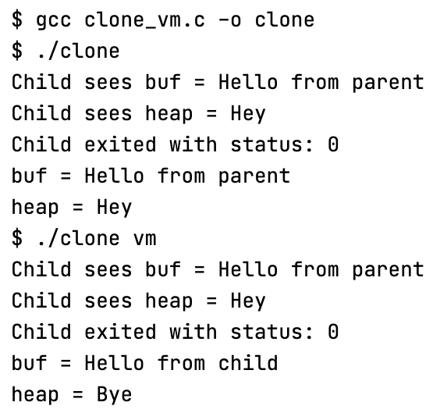
Example of clone()
If we pass CLONE_VM flag to clone(), the memory space will be shared between the calling process and the child process, so the modifications made on the child process will be reflected in the calling process:
No CLONE_VM flag, buf and heap remains unchanged
Pass CLONE_VM flag, buf and heap changed

Slide 26
CPU Scheduler
The CPU scheduling is the task of selecting a waiting process from the ready queue (one or multiple queues) and allocating the CPU to it. The CPU is allocated to the selected process by the dispatcher.
The non-preemptive scheduling is invoked when the process running on the CPU gives up the CPU voluntarily
Switches from running to waiting state, e.g., I/O request, or wait()
Terminates
The preemptive scheduling - where the CPU can be taken away from a process involuntarily can further be invoked when
Switches from running to ready state, e.g., quantum (timer) expires in RR scheduling
Switches from waiting to ready (e.g., completion of I/O) or from new to ready (new process with higher priority) - in SRTF or MLFQ scheduling

Slide 27
Scheduling Criteria
Waiting time – amount of time a process waiting in the ready queue
Turnaround time – defined as the time at which the process completes minus the time at which the process arrived in the system
Considering single CPU burst, turnaround time = waiting time + CPU burst time
Response time – the amount of time it takes from when a request was submitted until the first response is produced
This is relevant to interactive programs (typically using RR scheduling)
Fairness
Resources such as CPU are utilized in some “fair” manner
Performance (such as turn-around time) and fairness are often at odds, in which optimizing performance often sacrifice fairness

Slide 28
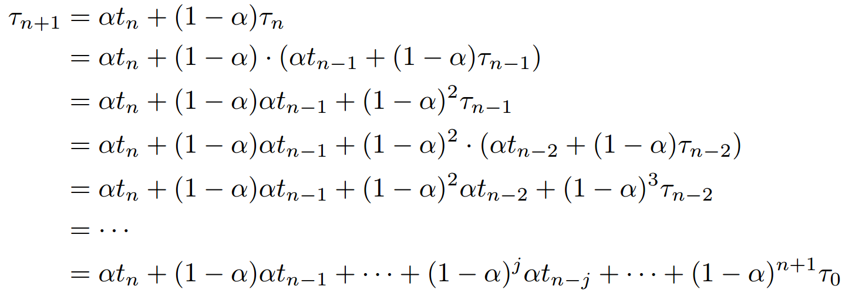
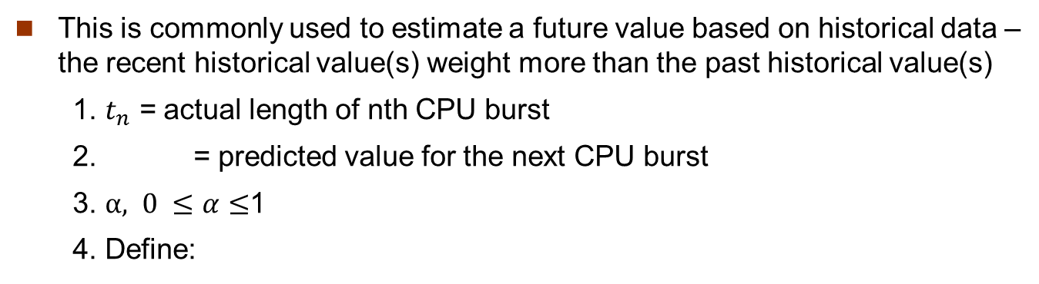
Exponential Averaging Algorithm
This is commonly used to estimate a future value based on historical data – the recent historical value(s) weight more than the past historical value(s)
1. $t_{n}$ = actual length of nth CPU burst
2. = predicted value for the next CPU burst
3. $α, 0 ≤α≤$1
4. Define:
If we expand the formula, we get:

Slide 29
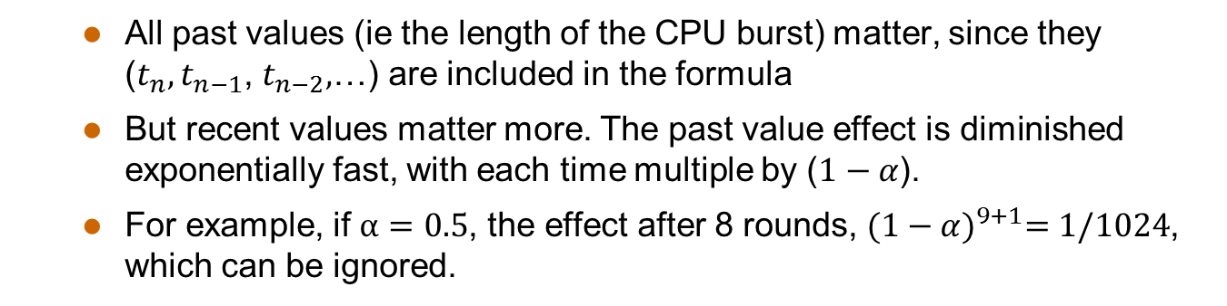
Exponential Averaging Algorithm
This is commonly used to estimate a future value based on historical data – the recent historical value(s) weight more than the past historical value(s)
1. $t_{n}$ = actual length of nth CPU burst
2. = predicted value for the next CPU burst
3. $α, 0 ≤α≤$1
4. Define:
If we expand the formula, we get:
All past values (ie the length of the CPU burst) matter, since they ($t_{n},t_{n−1}$, $t_{n−2},$…) are included in the formula
But recent values matter more. The past value effect is diminished exponentially fast, with each time multiple by ($1−α$).
For example, if $α=0.5$, the effect after 8 rounds, ${(1−α)}^{9+1}=1/1024$, which can be ignored.

Slide 30
First-Come, First-Served (FCFS) Scheduling
First-Come, First-Served （FCFS） means the firstly arrived process can be firstly served.
FCFS is also known as First-In, First-Out (FIFO).
Although FCFS is simple, it also has many good properties, eg
easy to implement
works pretty well under specific assumptions

Slide 31
FCFS Scheduling: Example
Process | Burst Time
P1 | 7
P2 | 4
P3 | 1
P4 | 4
We assume the
arrival order is
P1, P2, P3, P4
P1
P2
P3
P4
0
7
11
12
16
We assume the processes arrive in this order: P1, P2, P3, P4
Waiting time for P1=0, P2=7, P3=11, P4=12
Average waiting time: (0+7+11+12)/4=7.5

Slide 32
Round Robin (RR) Scheduling
Each process gets a small unit of CPU time (time quantum), usually 10-100 milliseconds. After quantum expires, the process is preempted (OS timer interrupt) and added to the end of the ready queue.
Suppose n processes in the ready queue and the time quantum is q
In chunks of at most q time units at once.
No process waits more than (n-1)q time units
Performance
q large ⟹ FCFS
q small ⟹ Interleaved (resemble process sharing)
q must be large with respect to context switch, otherwise overhead is too high

Slide 33
RR Scheduling: Example 1
Process | Burst Time
P1 | 7
P2 | 4
P3 | 1
P4 | 4
We assume the
arrival order is
P1, P2, P3, P4
P1
P2
P3
P4
0
7
11
12
16
When time quantum q is 8, which is larger than the longest burst time among the process.
The Gantt chart is the same as that of FCFS.
Waiting time for P1=0, P2=7, P3=11, P4=12
Average waiting time: (0+7+11+12)/4=7.5

Slide 34
RR Scheduling: Example 2
Process | Burst Time
P1 | 7
P2 | 4
P3 | 1
P4 | 4
We assume the
arrival order is
P1, P2, P3, P4
P1
P2
P3
P4
P1
0
4
8
9
13
16
When time quantum q is 4
Waiting time for P1=(13-4)=9, P2=4, P3=8, P4=9
Average waiting time: (9+4+8+9)/4=7.5

Slide 35
RR Scheduling: Example 3
Process | Burst Time
P1 | 7
P2 | 4
P3 | 1
P4 | 4
We assume the
arrival order is
P1, P2, P3, P4
P1
P2
P3
P4
P1
P2
P4
P1
P1
0
2
4
5
7
9
11
13
15
16
When time quantum q is 2
Waiting time for P1=5+4=9

Slide 36
RR Scheduling: Example 3
Process | Burst Time
P1 | 7
P2 | 4
P3 | 1
P4 | 4
We assume the
arrival order is
P1, P2, P3, P4
P1
P2
P3
P4
P1
P2
P4
P1
P1
0
2
4
5
7
9
11
13
15
16
When time quantum q is 2
Waiting time for P1=9, P2=2+5=7

Slide 37
RR Scheduling: Example 3
Process | Burst Time
P1 | 7
P2 | 4
P3 | 1
P4 | 4
We assume the
arrival order is
P1, P2, P3, P4
P1
P2
P3
P4
P1
P2
P4
P1
P1
0
2
4
5
7
9
11
13
15
16
When time quantum q is 2
Waiting time for P1=9, P2=7, P3=4

Slide 38
RR Scheduling: Example 3
Process | Burst Time
P1 | 7
P2 | 4
P3 | 1
P4 | 4
We assume the
arrival order is
P1, P2, P3, P4
P1
P2
P3
P4
P1
P2
P4
P1
P1
0
2
4
5
7
9
11
13
15
16
When time quantum q is 2
Waiting time for P1=9, P2=7, P3=4, P4=5+4=9

Slide 39
RR Scheduling: Example 3
Process | Burst Time
P1 | 7
P2 | 4
P3 | 1
P4 | 4
We assume the
arrival order is
P1, P2, P3, P4
P1
P2
P3
P4
P1
P2
P4
P1
P1
0
2
4
5
7
9
11
13
15
16
When time quantum q is 2
Waiting time for P1=9, P2=7, P3=4, P4=9
Average waiting time: (9+7+4+9)/4=7.25 (better than FCFS, 7.5)

Slide 40
Shortest-Job-First (SJF) Scheduling
Associate with each process the length of its next CPU burst. Use these lengths to schedule the process with the shortest time
Two schemes:
Non-preemptive – once the CPU is allocated to a process, it cannot be preempted until the completion of its current CPU burst
Long
Short
SJF is optimal – yields the minimum average waiting time for a given set of processes
Short
Long

Slide 41
SJF Scheduling: Example
Process | Burst Time | Arrival Time
P1 | 7 | 0
P2 | 4 | 0
P3 | 1 | 0
P4 | 4 | 0
P3
P2
P4
P1
0
1
5
9
16
Since P2 and P4 have the same burst time, we first schedule P2, then P4
Waiting time for P1=9, P2=1, P3=0, P4=5
Average waiting time: (9+1+0+5)/4=3.75 (better than FCFS and RR)

Slide 42
Shortest-Job-First (SJF) Scheduling
Associate with each process the length of its next CPU burst. Use these lengths to schedule the process with the shortest time
Two schemes:
Non-preemptive – once the CPU is allocated to a process, it cannot be preempted until the completion of its current CPU burst
Preemptive – if a new process arrives with CPU burst length less than remaining time of current executing process, preempt. This scheme is also know as the Shortest-Remaining-Time-First (SRTF)

Slide 43
SRTF Scheduling: Example
Process | Burst Time | Arrival Time | Remaining Time
P1 | 7 | 0 | 7
P2 | 4 | 2
P3 | 1 | 4
P4 | 4 | 5
P1
0
2

Slide 44
SRTF Scheduling: Example
Process | Burst Time | Arrival Time | Remaining Time
P1 | 7 | 0 | 5
P2 | 4 | 2 | 4
P3 | 1 | 4
P4 | 4 | 5
P1
P2
0
2
4
P1 gets preempted at time 2

Slide 45
SRTF Scheduling: Example
Process | Burst Time | Arrival Time | Remaining Time
P1 | 7 | 0 | 5
P2 | 4 | 2 | 2
P3 | 1 | 4 | 1
P4 | 4 | 5
P1
P2
P3
0
2
4
5
P1 gets preempted at time 2
P2 gets preempted at time 4

Slide 46
SRTF Scheduling: Example
Process | Burst Time | Arrival Time | Remaining Time
P1 | 7 | 0 | 5
P2 | 4 | 2 | 2
P3 | 1 | 4 | 0
P4 | 4 | 5 | 4
P1
P2
P3
P2
0
2
4
5
7
P1 gets preempted at time 2
P2 gets preempted at time 4

Slide 47
SRTF Scheduling: Example
Process | Burst Time | Arrival Time | Remaining Time
P1 | 7 | 0 | 5
P2 | 4 | 2 | 0
P3 | 1 | 4 | 0
P4 | 4 | 5 | 4
P1
P2
P3
P2
P4
0
2
4
5
7
11
P1 gets preempted at time 2
P2 gets preempted at time 4

Slide 48
SRTF Scheduling: Example
Process | Burst Time | Arrival Time | Remaining Time
P1 | 7 | 0 | 0
P2 | 4 | 2 | 0
P3 | 1 | 4 | 0
P4 | 4 | 5 | 0
P1
P2
P3
P2
P4
P1
0
2
4
5
7
11
16
P1 gets preempted at time 2
P2 gets preempted at time 4

Slide 49
SRTF Scheduling: Example
Process | Burst Time | Arrival Time | Remaining Time
P1 | 7 | 0 | 0
P2 | 4 | 2 | 0
P3 | 1 | 4 | 0
P4 | 4 | 5 | 0
P1
P2
P3
P2
P4
P1
0
2
4
5
7
11
16
Waiting time for P1=(11-2)=9, P2=1, P3=0, P4=(7-5)=2
Average waiting time: (9+1+0+2)/4=3 (better than SJF, 3.75)

Slide 50
Priority Scheduling
A priority number (integer) is associated with each process
The CPU is allocated to the process with the highest priority (smallest integer ≡ highest priority), it can be
Preemptive （upon new arrival of a higher priority process)
Non-preemptive
Equal-priority processes are scheduled in FCFS order
SJF is a special case of the general priority-scheduling algorithm, where priority is the inverse of predicted next CPU burst time
Problem ≡ Starvation – low priority processes may never execute
Solution ≡ Aging – as time progresses increase the priority of the process

Slide 51
Priority Scheduling: Example
Process | Burst Time | Arrival Time | Priority
P1 | 7 | 0 | 4
P2 | 4 | 0 | 1
P3 | 1 | 0 | 2
P4 | 4 | 0 | 3
P2
P3
P4
P1
0
4
5
9
16
Waiting time for P1=9, P2=0, P3=4, P4=5
Average waiting time: (9+0+4+5)/4=4.5

Slide 52
Q.1
Response time vs. turnaround time
Answer: The turnaround time is the sum of the periods that a process is spent waiting to get into memory, waiting in the ready queue, executing on the CPU, and doing I/O. Turnaround time essentially measures the amount of time it takes to execute a process.
Response time, on the other hand, is a measure of the time that elapses between a request and the first response produced.
The confusion could be, when we compute response time and turn around time in the examples of FCFS and SFJ, with a single CPU burst time of each process, both appear to be the same. However, we usually are only concerned with turn-around time in FCFS and SJF, and only consider response time in RR scheduling.

Slide 53
Q.2
Waiting time vs. turnaround time
Answer: For one singe CPU burst time, no matter what scheduling algorithm is used, turn-around time = CPU burst time (may be executed in multiple time, because of being pre-empted by high-priority process or quantum expiration) + waiting time.
In another word, for a single CPU burst time, the turn-around time can be “easily” computed by the time the process completes its CPU burst time minus the arrival time (the time to join the ready queue initially).
Waiting time = turn-around time – CPU burst time

Slide 54
Q.3
Explain the process of starvation and how aging can be used to prevent it.
Answer: Starvation occurs when a process is ready to run but is stuck waiting indefinitely for the CPU. This can be caused, for example, when higher-priority processes prevent low-priority processes from ever getting the CPU. Aging involves gradually increasing the priority of a process so that a process will eventually achieve a high enough priority to execute if it waited for a long enough period of time.

Slide 55


